Slide 1
Big Plan – SU Staff Team
25th January 2016

Slide 2
Welcome to SU Greenwich

Slide 3
Student Governance

Slide 4
How we run…

Slide 5
Greenwich – Cooper Building
Student Voice and Sabbatical Officers
Student Activities
Advice Service
Bar Latitude, Pool Room and Lounge
Activities Room
Latitude Media
Finance, Office Management and HR
Marking and Insights
Senior Management

Slide 6
Avery Hill
Student Activates Help Desk
Sports Development and Kit store
Advice Service
Village Shop
Sparrows
University Ran services
Dome
Sports Hall, Gym and Sports pitches
Accommodation

Slide 7
Medway

Slide 8
Our staff team

Slide 9
The Big Plan
NUS Member research November 2015
Trustee board feedback following work with NUS strategic support unit and August 2016 trustee meeting
Consultation with SU Staff, SU Officers, University, Utilising NUS member research and John’s observations

Slide 10
Update on the process to date
NUS Diagnostic
Bars Review (Nina and Co.)
Communications Review
NUS Member Research
NUS board and strategy development work
Sabb and Senior Managers Away day – 6th May 2016
SU staff away day 27th May
SMT and Managers – SWOT and planning exercise

Slide 11
The survey
590 respondents
Nearly a third of students (65%) were aged 18-22. 84% were under 30
There was a female bias in the number of respondents, with females accounting for two thirds overall (66%)
Over three fifths (62%) were UK citizens
65% of respondents were white British
10% were a parent or guardian
13% considered themselves to have a disability, while
12% were living with someone with a disability
7% had caring responsibilities
Focus groups – October 2015 with 26 students

Slide 12
Member research by NUS
A high portion of students said they didn’t consider themselves to be ‘traditional students’.
Living/travel arrangements:
25% of student live at home with parents or guardians 30% in halls of residence and
26% in a shared rented house
10% of students were parents or guardians
55% of students could be considered “commuters” 9% of students say they travel more
than 2 hours per day.
Background:
Majority of students age 18-22 (65%)
62% UK citizen
65% White
Involvement
36% of students describe themselves and not being at all engaged
46% of students had visited the website
24% of students

Slide 13
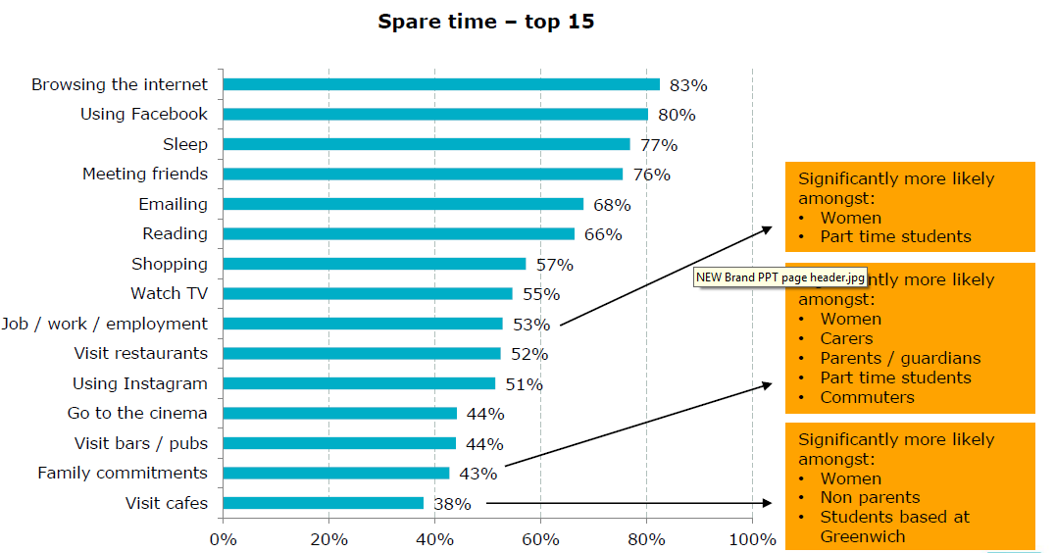
What do our students do with their spare time?

Slide 14
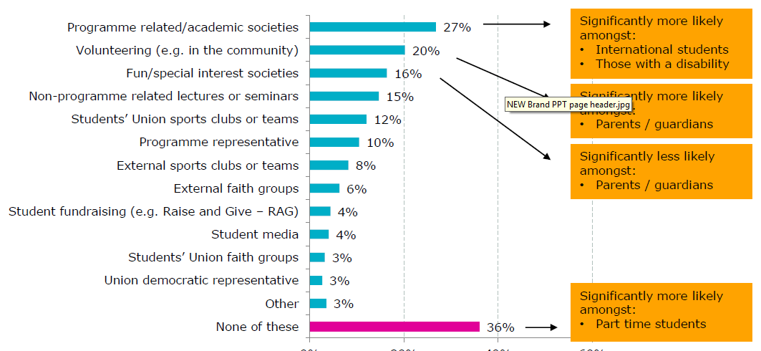
Extracurricular activities

Slide 15
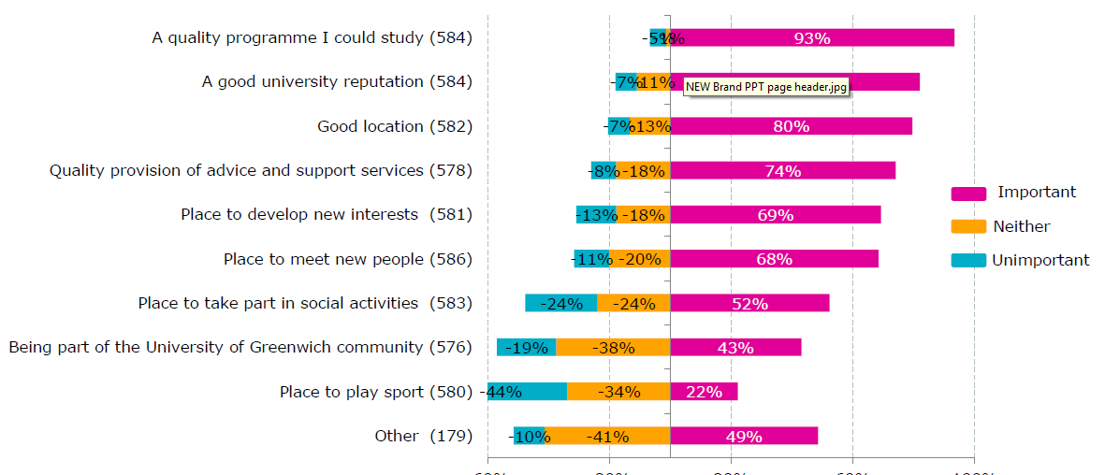
Factors for choosing Greenwich

Slide 16
Significant differences
Being part of the Greenwich University community is significantly more likely amongst International students and full time students
A place to meet new people is significantly more likely amongst undergraduates, full time students, non commuters and those living in halls of residence
A place to play sports is significantly more likely amongst students based at Medway
A place to take part in social activities is significantly more likely amongst younger students, women, international students, full time students and those living in halls of residence

Slide 17
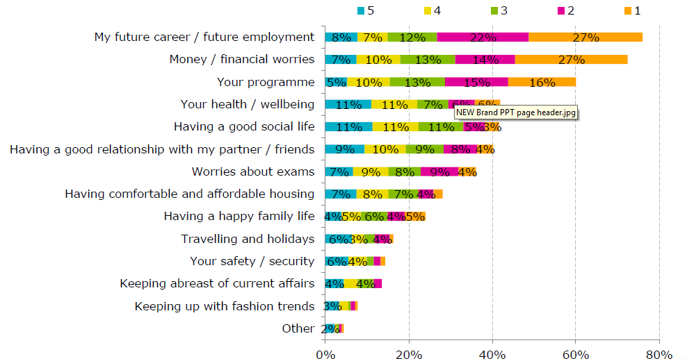
Top things on people’s minds

Slide 18
Why students consider leaving

Slide 19
Shaping the SU

Slide 20
Quality of interactions

Slide 21
Aims by graduation

Slide 22
Role of the SU

Slide 23
Describing the SU

Slide 24
Accessibility and accountability

Slide 25
Strengths and weaknesses

Slide 26
Importance of SU provision

Slide 27
Continued.

Slide 28
Engagement with the SU

Slide 29
Frequency visiting shops and bars
Do they know they are SU ran?

Slide 30
Involvement in our services

Slide 31
continued.

Slide 32
Threats and opportunities

Slide 33
What we want:
For all students to make the most of their journey at Greenwich
How do we realise this:
We empower students to have life changing experiences which help them shape their futures and the world around them
REPRESENT our members & help them
EFFECT CHANGE
Ensure our members have the best STUDENT EXPERIENCE
Enterprise
People
Communication
Spaces
Partnerships
EMPOWERING
COURAGEOUS
DEDICATED
TRUSTED
APPROACHABLE

Slide 34
Our Values
Approachable
We will be as approachable as possible, promoting diversity in our teams and creating open, welcoming and safe spaces.
Our activities will be joined up, effectively communicated by visible champions and always centred by our customers.
Courageous
We will be courageous in our endeavours, facing down any challenge with pro-active innovation.
We will take risks, accept and learn from our mistakes, striving always to improve and grow.
Dedicated
We are dedicated to listening to our members, aiming always to improve our services.
We will ensure an equality of representation and will work hard to develop and care for ourselves, our teams and our members.
Trusted
We will earn trust by living our values as a democratic body.
We will put Fairtrade, ethics and sustainability at the centre of our work as a not for profit organisation.
We will provide responsive advice and care to a membership that will come to rely on the strength of our word.
Empowering
We will seek to empower our members and ourselves, ensuring we all increase our capacity to live well and find enrichment in our work.
We will ensure all diverse voices are liberated, that students and their needs lead our organisation and that we celebrate our successes together.

Slide 35
REPRESENT our members and help them EFFECT CHANGE
Build a thriving student representation system run by the SU
Ensure student Consultation is at the heart of the SU
Increase engagement from different student communities with SU democratic process to increase the quality of student voice

Slide 36
Ensure our members have the best STUDENT EXPERIENCE
Become the experts of students needs at Greenwich across our different member communities
SU services demonstrate clear outcomes that improve/influence our members journey at Greenwich
Through engagement with the SU, help our members become more employable
Build a strong SU community to build a sense of belonging and pride to Greenwich

Slide 37
Enterprise
Provide more creative opportunities student enterprise
Put money back into students pockets
Develop our existing services and maximise income to invest back into membership services

Slide 38
People
Develop a people focused culture at the SU
Our workforce represents our membership
SU is a great place to work
Develop our student staff and volunteer skills

Slide 39
Communication
Promote the impact and benefit of the SU on student life
Multichannel promotion of SU services and campaigns
Student consultation drives insights and campaigns
Demystify SU language and barriers to communication

Slide 40
Spaces
To make the SU mobile to engage better with members
Develop Digital Experience (that match physical) to build online SU community
Commit ongoing investment into existing and new SU spaces

Slide 41
Partnerships
Build local partnerships to:
Increase awareness, trusts in the SU and generate addition income for membership services
Improving the student impact on the community of Royal Borough of Greenwich
Develop strong working relationships with our University partnership

Slide 42
Next Steps
November 2016 - Sign off by Board
December 6th - Present to University Executive
December 7th - Present to Student Council
January – February 2017, Staff and Officers complete operational plan
January – March 2017 – Student consultation on actions
January – March 2017 - Outline outcomes framework to support operational detail
February – March 2017 Set draft Y1 budget and Y3 approx. budget
March 2017 – present budget to Vice Chancellor and Finance Director
April 2017 – Aim to complete HR project to support plan
April 2017 - Present to Trustee board
June – July 2017 – New appraisals for staff
August 2017 – plan starts

Slide 43
REPRESENT our members and help them EFFECT CHANGE
Build a thriving student representation system run by the SU
Every Course is represented
Increase NSS scores on new question 26, to be top in London, post 1992 Universities
Investment in team to provide ongoing training and development to student reps
Play a role in halls of residents representation
Democatic review
Student Consultation is at the heart of the SU
How we consult is improved, more regular and standardised
Increased quality in the data and learning from consulting
Clear feedback based on needs rather than just wants
Consultation truly helps shape work and role of the SU
Increase engagement from different student communities with SU democratic process to increase the quality of student voice
More student voices heard across communities (especially PT, Post Grad Commuters, BAME, Placement)
Voter turn out increased to 25% (5,500)(currently 16%)
More support given to PT Officers and Student Councilors
SU takes democracy seriously, providing quality and fair appeals, elections and referenda - democratic roles promoted well
Improve the quality of the vote by improving student awareness of what they are voting for
More creative ways of voting
Increase awareness of roles, importance of the leadership and impact it makes
Engagement at a national level improves, Greenwich recognised as a good practice SU
Make accessible

Slide 44
Ensure our members have the best STUDENT EXPERIENCE
Become the experts of students needs at Greenwich across our different member communities
Understand who are communities are
Build relationships with key influencers
What SU says is trusted, respected and acted on
Increase participation in SU services from sports, societies, voice and advice
SU services demonstrate clear outcomes that improve/influence our members journey at Greenwich
Outcome framework for SU services
Measure quality of SU services and act to improve
Adapt, close services or set up new services based on member needs
SU plays a role in the decision for students wanting to come to Greenwich
Through engagement with the SU, help our members become more employable
Taking part in SU improves our members CV and graduate opportunities
Provide volunteer and accreditation services
Offer employment opportunities to members and employment services
Work closely with UoG initiatives and compliment
Build a strong SU community to build a sense of belonging and pride to Greenwich
Utilise SU buildings and Dreadnought to develop social, group and study spaces for students
Support retention
Campaign to improve services at Avery Hill and other halls
Work with GK Unions to support Medway students
SU provides safe, fun and flexible spaces

Slide 45
Enterprise
Provide more creative opportunities student enterprise
Encourage student innovation and provide a space for this to thrive
Develop student led services
Pop up enterprise and ideas explored within the SU linked to Uni (don’t duplicate)
Students develop enterprise skills, volunteering and working at the SU
Put money back into students pockets
Providing jobs for students and becoming a London Living Wage employer
Saving students money
Proving our value as a Not for profit organisation
Value for money (think before we spend)
Develop our existing services and maximise new income to invest back into membership services
Exploit online media and marketing income
Improve services offered by SU to be more relevant to SU needs, including open a new outlet in Dreadnought e.g. letting agency and employment agency
Focus on business development to explore local and national income streams
Develop Trust and Foundation income to improve student experience and services

Slide 46
People
Develop a people focused culture at the SU
Dedicated training and development
Career progression
Team learning, secondment, job swaps, mentoring
Our workforce represents our membership
Provide feedback at all stages of interview process
Employment opportunities that attract a diverse and talented team
Roles are benchmarked and targeted to broad communities
SU is place people want to work from all communities
SU is a great place to work
Success is celebrated and rewarded
Hygiene factors are addressed e.g. terms and conditions
Dedicated HR support
IIP accredited
Employability fits
Develop our student staff and volunteer skills
Accreditation
Appraisal
Mentoring and support
Dedicated resource

Slide 47
Communication
Promote the impact and benefit of the SU on student life
Show where student money goes
Outline real costs of SU services and subsidised services
Demonstrate the change members have made
Collate data to provide timely and accurate member insights
Multichannel promotion of SU services and campaigns
Clear, quality and responsive integrated campaigns
Promote SU membership and commercial services
Interactive and engaging social media
Online services have a link to our physical spaces
Student consultation drives insights and campaigns
Annual survey to understand member needs
All staff play a role in speaking to students
Demonstrate SU outcomes to members
Share feedback with key partners to help improve experience
Demystify SU language and barriers to communication
SU Rebrand
Make language relevant, Explain terms
Take time to share
Transform our understanding of our members and theirs regarding the SU

Slide 48
Spaces
To make the SU mobile to engage better with members
Take the SU to our members, improvising visibility and engagement
Get SU staff and representatives out of SU offices and engaging with the membership
Utilise UoG Campus to promote the SU
Give SU space to members for student use e.g. Latitude Media
Develop Digital Experience (that match physical) to build online SU community
Reactive and interactive SU
Open, accessible and quick to respond
Online services
Online consultation
Commit ongoing investment into exiting and new SU spaces
Work closely with University partners, especially estates team
Annual capital investment to improve SU facilities and maintain quality
Build designated reserves to allow for investment
Consult with members about their needs for their spaces and act on responses
Make Dreadnought the central space and thriving space for Students at Greenwich (the place to be)
Thriving and flexible building that adapts to members needs throughout the day
Visually and technologically relevant and changing
Equal opportunities at all campuses

Slide 49
Partnerships
Increase awareness, trusts in the SU and generate addition income for membership services
Improving the student impact on the community of Royal Borough of Greenwich
Increase awareness, trusts in the SU
Improve student image and impact to the community of Royal Borough of Greenwich
Utilise what local community has to offer to improve participation and student experience
SU spaces can be used as community spaces
Raise additional income for the SU
Develop strong working relationships with our University partnership
Demonstrate value for money
Promote the benefit and vital role of SU
To be a critical friend and challenger
To be a an active part of University and campus life

